Slide 1
Final presentation for MSc project
Automated torso soft tissue segmentation for spine modelling in CT scan
Reporter: Huijing Zhou
Supervisor: Dr Spyros Masouros
Date: 01/09/2021

Slide 2
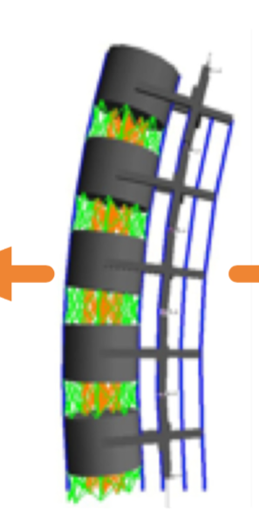
Multi-body model
[1]
[1] Gao Z, Gibson I, Ding C, et al. (2015) Procedia Technology

Slide 3
Masses
Centroids

Slide 4
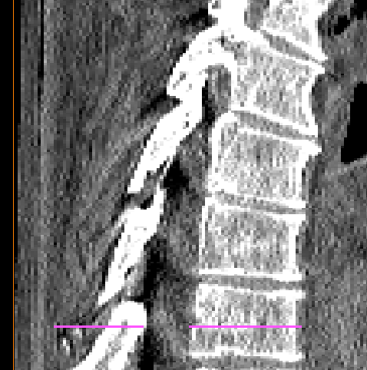
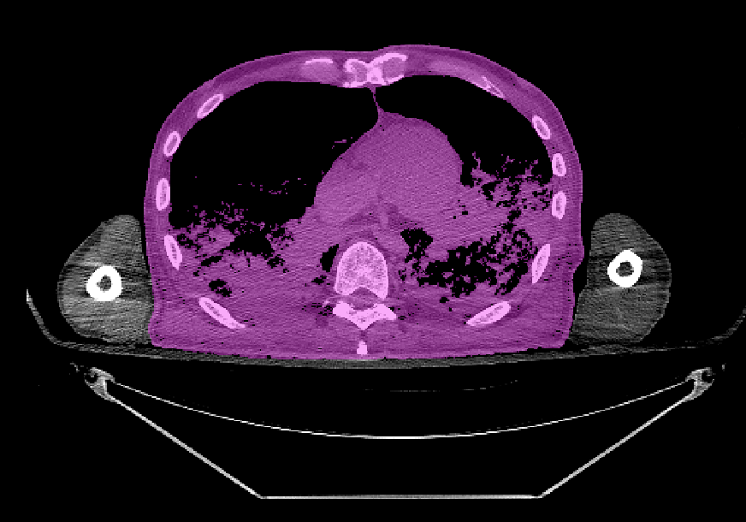
Slice height
Slices across the centroids

Slide 5
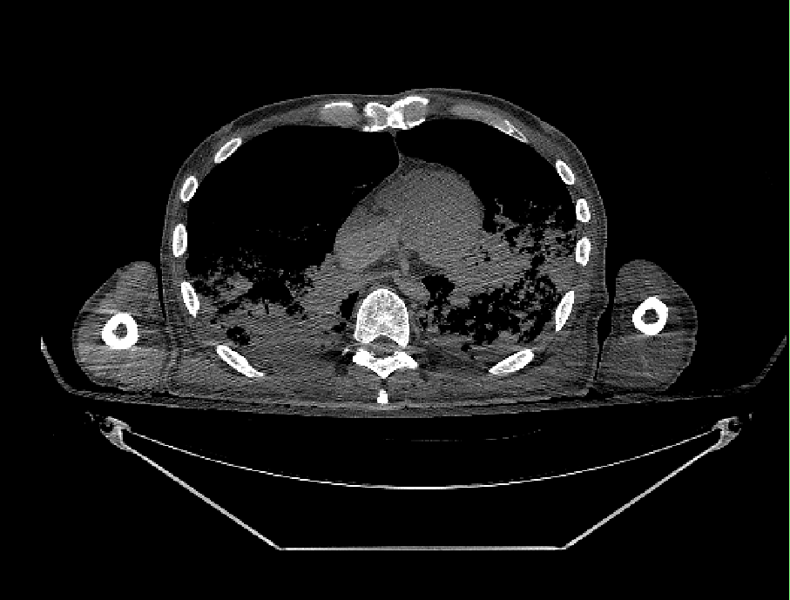
Original image

Slide 6
Target region
Original image

Slide 7
Body cavity
Target region
Original image
CT bed projection
Arms

Slide 8
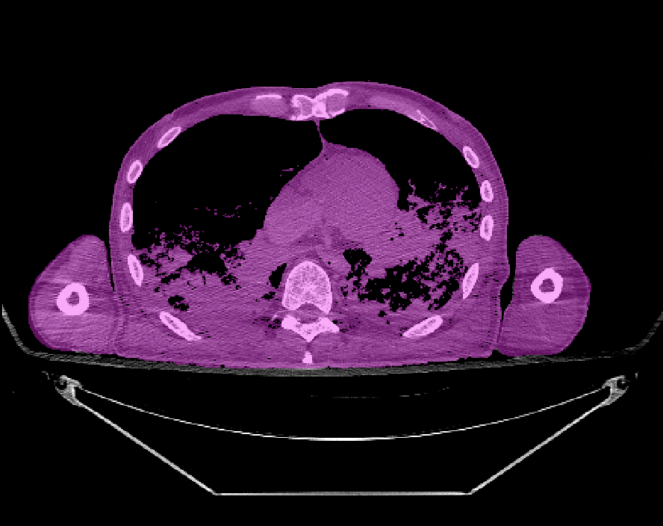
Framework
Original CT scan image
CT scanner bed removal
Arm removal
Soft tissue
Torso soft tissue
Initial torso segmentation
Body cavity removal
Sectional torso volumes/masses
Combined with vertebral
Torso soft tissue areas
body height research done previously
Torso soft tissue centroids

Slide 9
Framework
Original CT scan image
CT scanner bed removal
Arm removal
Soft tissue
Torso soft tissue
Initial torso segmentation
Body cavity removal
Sectional torso volumes/masses
Combined with vertebral
Torso soft tissue areas
body height research done previously
Torso soft tissue centroids

Slide 10
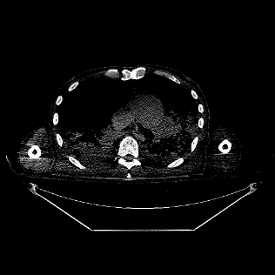
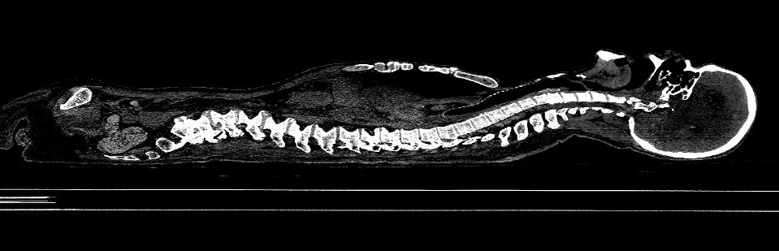
CT scanner bed removal – Sagittal bed

Slide 11
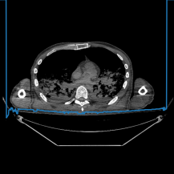
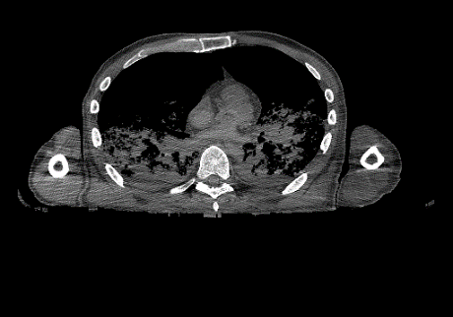
CT scanner bed removal – Sagittal bed
Blue line: CT bed top profile
After CT bed removal

Slide 12
CT scanner bed removal – Sagittal bed
Blue line: CT bed top profile
After CT bed removal
Average running time:
140.01s

Slide 13
CT scanner bed removal – Transverse bed
Average running time:
0.57s / slice
Remove the torso region
The CT bed projection
After CT bed removal

Slide 14
Framework
Original CT scan image
CT scanner bed removal
Arm removal
Soft tissue
Torso soft tissue
Initial torso segmentation
Body cavity removal
Sectional torso volumes/masses
Combined with vertebral
Torso soft tissue areas
body height research done previously
Torso soft tissue centroids

Slide 15
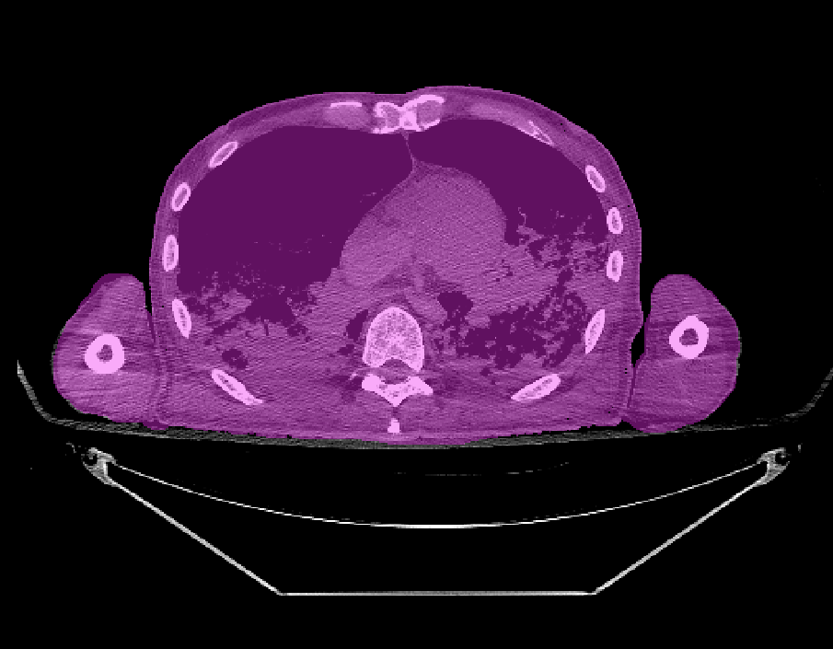
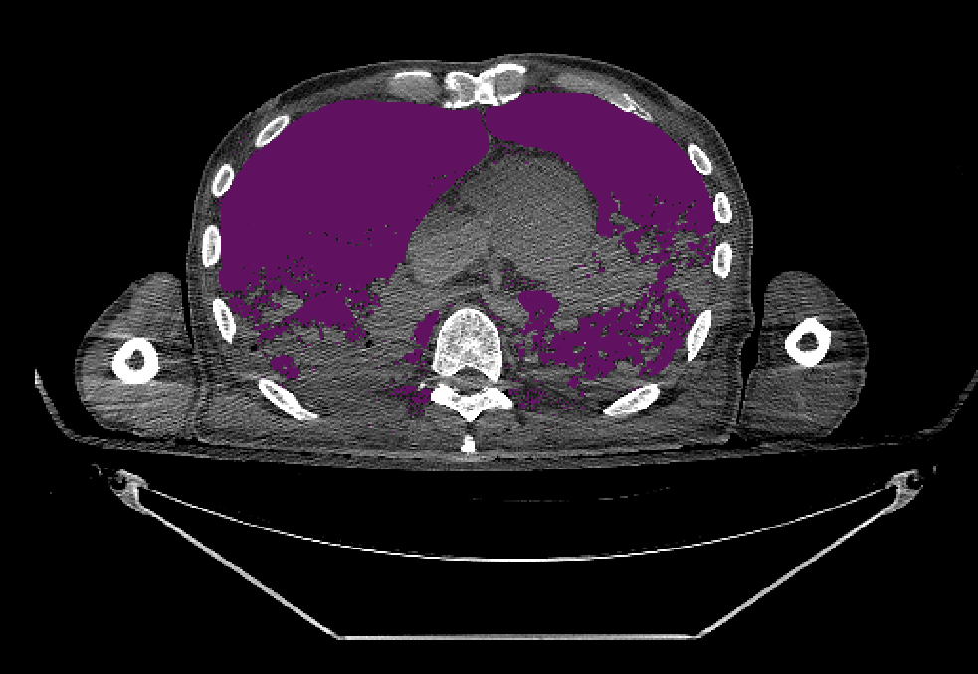
Soft tissue segmentation
= Initial torso mask – Body cavity mask

Slide 16
Soft tissue segmentation
Initial torso mask
Contrast stretching
Binarisation
Closing operator
Find maximum connected area
Fill all the holes
Get initial torso region

Slide 17
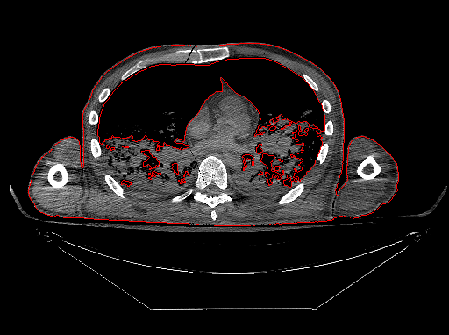
Soft tissue segmentation
Body cavity mask
Initial body cavity region =
Initial torso region –
Maximum connected area
Remove the small regions

Slide 18
Framework
Original CT scan image
CT scanner bed removal
Arm removal
Soft tissue
Torso soft tissue
Initial torso segmentation
Body cavity removal
Sectional torso volumes/masses
Combined with vertebral
Torso soft tissue areas
body height research done previously
Torso soft tissue centroids

Slide 19
Arm removal – Peak arm
Soft tissue region

Slide 20
Arm removal – Peak arm
Target region

Slide 21
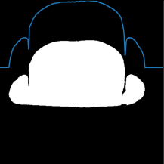
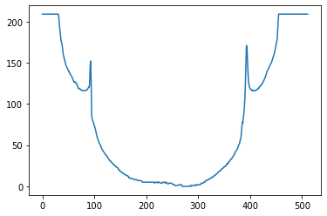
Arm removal – Peak arm
Sum all the pixel value of each column
A
B
A
B
Peak detection

Slide 22
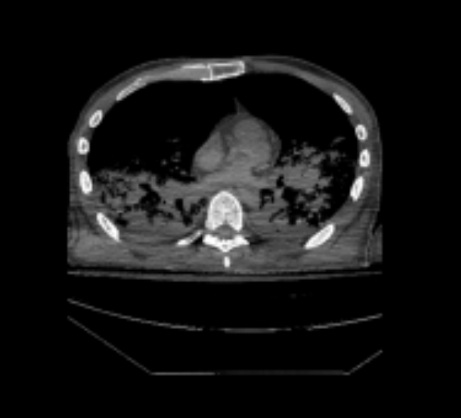
Arm removal – Peak arm

Slide 23
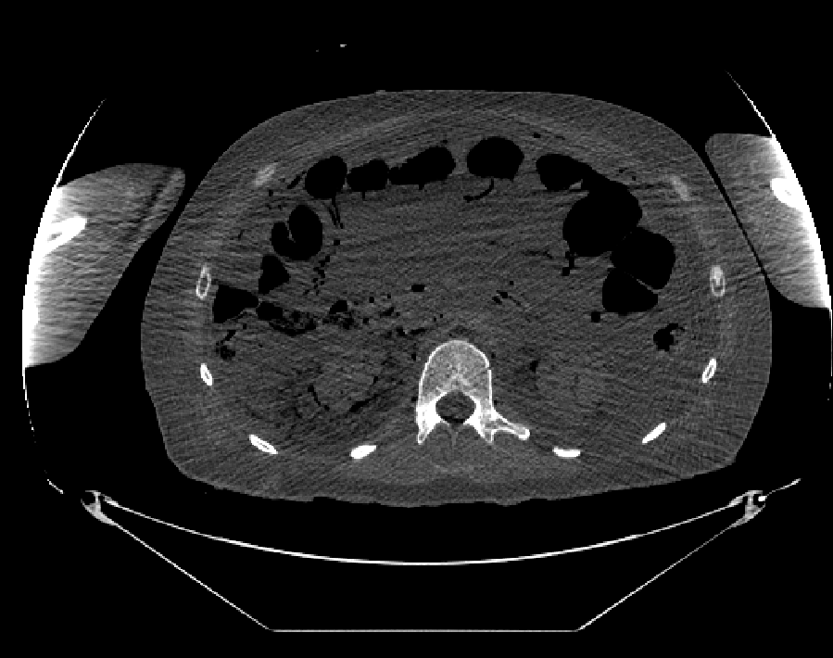
Arm removal – Peak arm limitation
They put the forearm on the stomach.

Slide 24
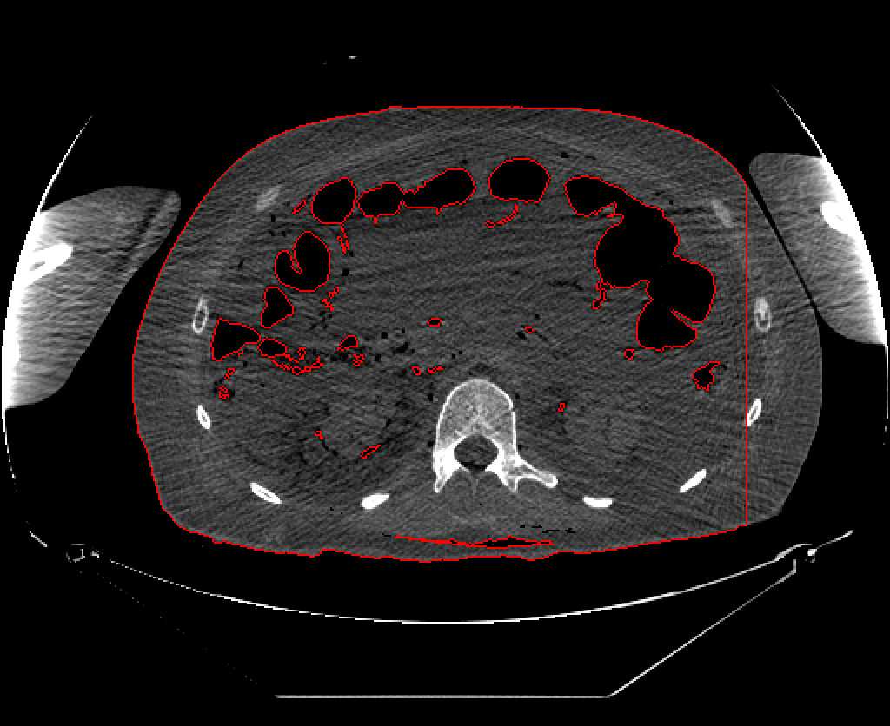
Arm removal – Peak arm limitation
After arm removal Peak arm

Slide 25
Arm removal – Watershed arm
Watershed algorithm

Slide 26
Arm removal – Watershed arm
Watershed algorithm

Slide 27
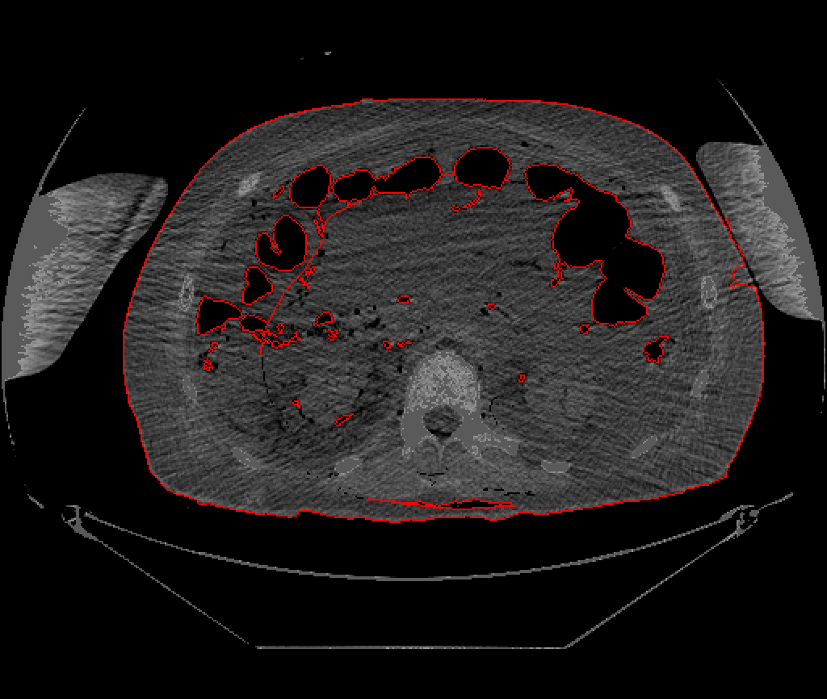
Arm removal – Peak & Watershed arm comparison
Peak arm
Watershed arm

Slide 28

Framework
Original CT scan image
CT scanner bed removal
Arm removal
Soft tissue
Torso soft tissue
Initial torso segmentation
Body cavity removal
Sectional torso volumes/masses
Combined with vertebral
Torso soft tissue areas
body height research done previously
$$C_{x}=\frac{\sum{C_{ix}A_{i}}}{\sum{A_{i}}}$$
$$C_{y}=\frac{\sum{C_{iy}A_{i}}}{\sum{A_{i}}}$$
Torso soft tissue centroids

Slide 29
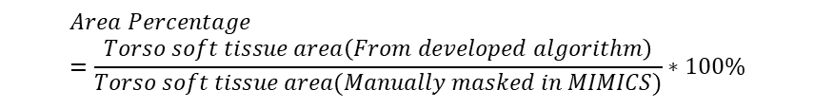
Framework
Original CT scan image
CT scanner bed removal
Arm removal
Soft tissue
Torso soft tissue
Initial torso segmentation
Body cavity removal
Sectional torso volumes/masses
Combined with vertebral
Torso soft tissue areas
body height research done previously
Torso soft tissue centroids
$$Area Percentage=\frac{Torso soft tissue area\left(From developed algorithm\right)}{Torso soft tissue area(Manually masked in MIMICS)}∗100\%$$

Slide 32
Running time/s
Database | Transverse bed + Peak arm | Sagittal bed + Peak arm | Transverse bed + Watershed arm | Sagittal bed + Watershed arm
606 -- 23 slices | 37.09 | 193.69 | 49.43 | 206.03
636 -- 15 slices | 26.29 | 157.34 | 62.89 | 188.33
526 -- 24 slices | 39.41 | 137.57 | 58.81 | 156.97
Avg per slice | 5.01 | 24.64 | 8.79 | 28.05
Key parameter setting number
Transverse bed + Peak arm | Sagittal bed + Peak arm | Transverse bed + Watershed arm | Sagittal bed + Watershed arm
7 | 6 | 6 | 5

Slide 33


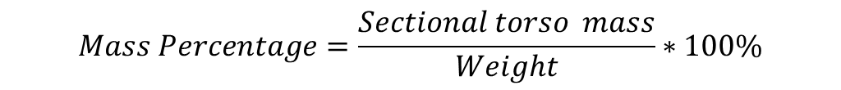
$$Sectional torso mass=Torso soft tissue area ∗Slice height∗Single density$$
$$Mass Percentage=\frac{Sectional torso mass}{Weight}∗100\%$$
$$Single density=1.04 g/cm^{3}$$
Slice height
Slices across the centroids

Slide 34
[2] Keenan B E, Izatt M T, Askin G N, et al. (2014) Clinical Biomechanics
[3] Pearsall D J, Reid J G, Livingston L A. (1996) Annals of biomedical engineering
[4] Duval-Beaupere G, Robain G. (1987) International orthopaedics

Slide 35
Conclusion & Future work
CT bed removal
Soft tissue segmentation
Arm removal
Sagittal bed
Transverse bed
Peak arm
Watershed arm
Improve speed
Automated slice selection
Search the peaks from other directions
Automated marker drawing

Slide 36
Thanks for listening
Automated torso soft tissue segmentation for spine modelling in CT scan
Reporter: Huijing Zhou
Supervisor: Dr Spyros Masouros
Date: 01/09/2021

Slide 37
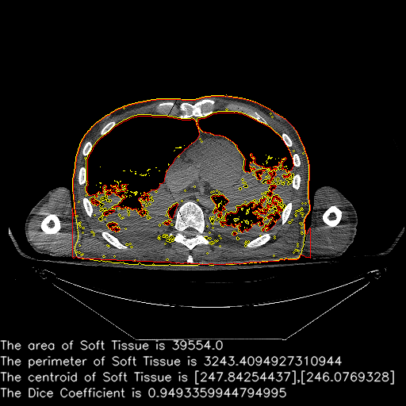
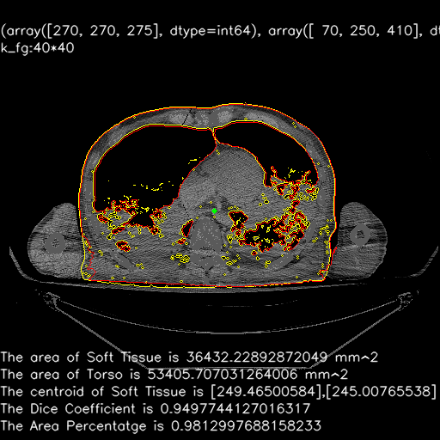

Slide 40
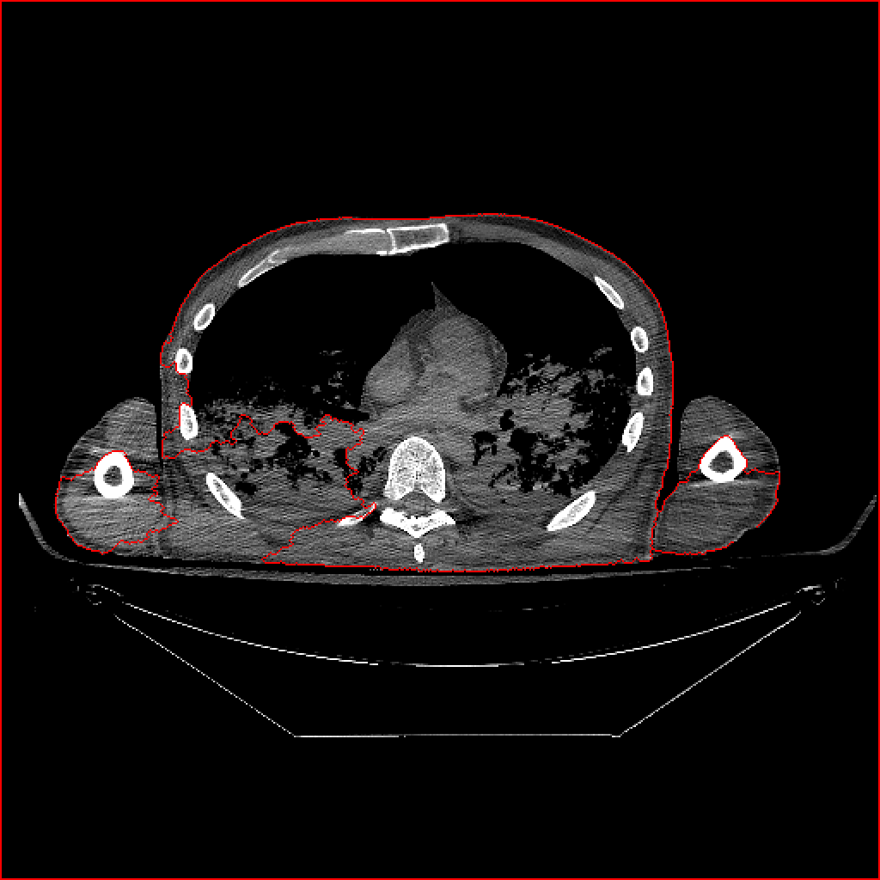
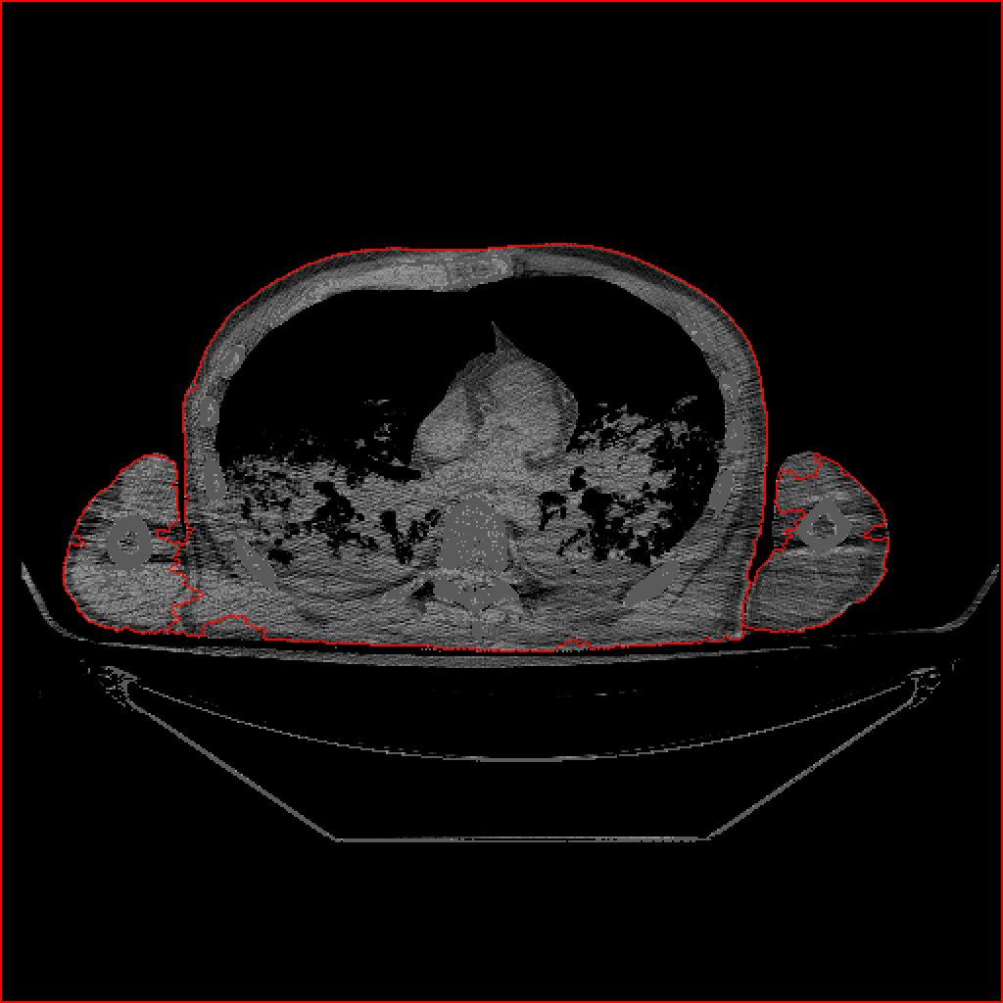
Arm Removal Experiment Results
Method – Watershed algorithm: Remove bone contrast
Bone Contrast Impact
Set the Bone Region = 90 HU
Sensitive, The best compromise

